Slide 1
welcome

Slide 2
Where did we come from? Why are we here? Where do we go when we die? What lies beyond? And what lay before? Is anything certain in life?

Slide 3
Content breakdown
Tutorial 1
The Rescorla-Wagner (Q-Learning) model
Tutorial 2
Hamiltonian Monte Carlo with cmdstanr
Tutorial 3
Extracting and interpreting parameters, and introducing offset parameters into your model
Tutorial 4
Good practices for computational modelling: Data simulation, parameter recovery and model comparisons

Slide 4
Cognitive Models
A model that describes how an individual performs a task (e.g., problem-solving, decision-making) or engages in a particular cognitive process. They are typically based upon psychological theory, e.g.,:
Prospect theory
Reinforcement Learning
Bayesian inference
Component process of working memory
Expectancy theory
“Traditional” models that simply regress the dependent measure on an assortment of experimental variables (e.g., questionnaire score, age, sex…) tell us very little about what goes on within cognition. These are essentially “black box” models.
We use cognitive models because they allow us to disentangle latent cognitive mechanisms, and hence make inferences about them.

Slide 5
Computational Modelling
What is it?
The use of a computer programme to simulate complex real-world systems and make forward predictions
Why use it?
In the cognitive sciences, mathematical models to describe cognitive processes are often too complex to be captured within a one-liner equation (e.g., linear regression)
Cognitive parameter values also tend to violate distributional assumptions. Some require imposed lower and upper bounds; others follow an exponential distribution… etc.
To reliably estimate cognitive parameter values, we need iterative, computational methods.

Slide 6
COMPUTATIONAL COGNITIVE MODEL
A model that explores and helps us understand various cognitive mechanisms, implemented through a computational process.

Slide 7


The Rescorla-Wagner (Q-Learning) Model
13 May 2024
Light and Divine Winds
Ruben Pang

Slide 8
Reinforcement Learning
Concept inspired by artificial intelligence and Pavlovian conditioning, and continues to be influential in training artificial intelligence nowadays
Agents learn to take a suitable action to maximize reward in a particular situation, often through trial and error
https://www.youtube.com/watch?v=L_4BPjLBF4E&t=0s

Slide 9
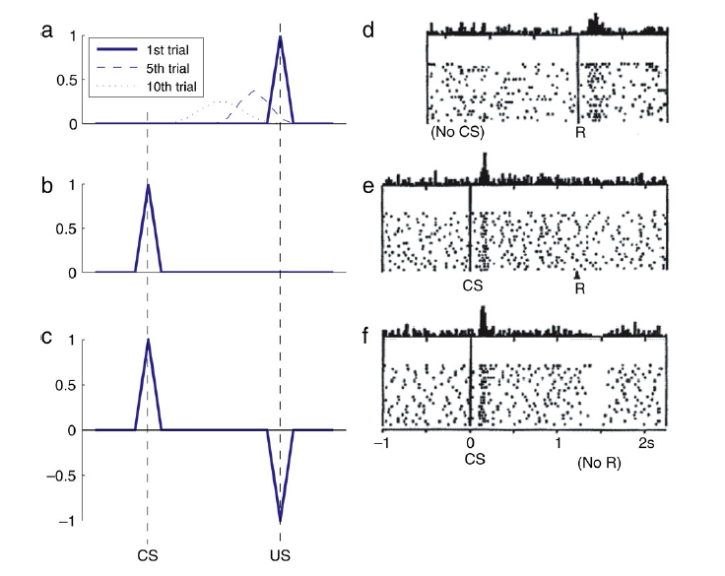
Reinforcement Learning in the Brain
Reward Prediction Error Hypothesis of Dopamine
Dopamine is instrumental for reward learning in the basal ganglia
The firing of dopaminergic neurons reflects a reward prediction error, where burst firing occurs in early stages of learning/training, but not later on when the agent has learned what the optimal decision is.
In Pavlovian conditioning, dopaminergic neurons exhibit a prediction error to the US in early trials, but this PE back-propagates temporally to the CS when the association is formed over several trials
Niv et al., 2005, Schultz et al., 1993
Niv, Y. (2009). Reinforcement learning in the brain. Journal of Mathematical Psychology, 53(3), 139-154. https://doi.org/10.1016/j.jmp.2008.12.005

Slide 10
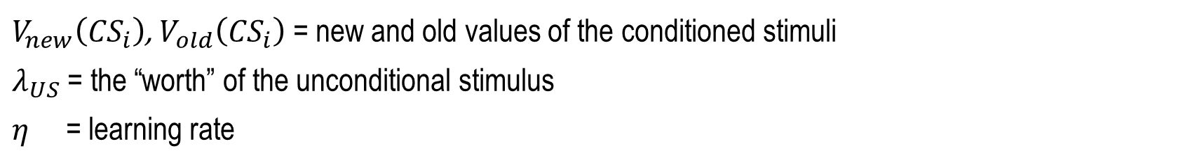

The Rescorla-Wagner model
$$V_{new}\left({CS}_{i}\right)=V_{old}\left({CS}_{i}\right)+ η\left[λ_{US}−\sum_{i}{V_{old}({CS}_{i})}\right]$$
$V_{new}\left({CS}_{i}\right)$, $V_{old}\left({CS}_{i}\right)$ = new and old values of the conditioned stimuli
$λ_{US}$ = the “worth” of the unconditional stimulus
$η$ = learning rate
Two axioms:
Learning only occurs when events are not predicted (violate expectations)
Predictions due to different stimuli are summed to form the total prediction in a trial

Slide 11
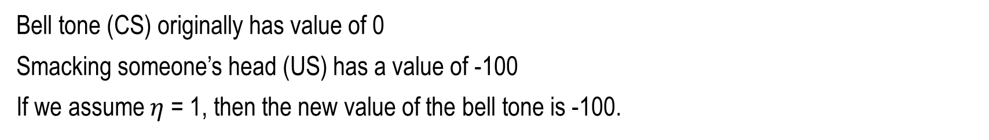
The Rescorla-Wagner model
$$V_{new}\left({CS}_{i}\right)=V_{old}\left({CS}_{i}\right)+ η\left[λ_{US}−\sum_{i}{V_{old}({CS}_{i})}\right]$$
Conditional stimulus = bell tone
Unconditional stimulus = smacking the person’s head
Response = wince in pain
Bell tone (CS) originally has value of 0
Smacking someone’s head (US) has a value of -100
If we assume $η$ = 1, then the new value of the bell tone is -100.

Slide 12
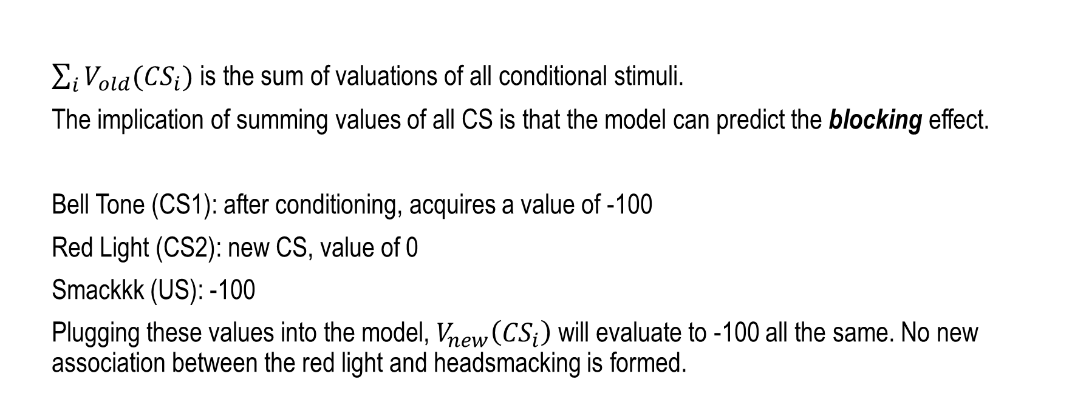
The Rescorla-Wagner model
$$V_{new}\left({CS}_{i}\right)=V_{old}\left({CS}_{i}\right)+ η\left[λ_{US}−\sum_{i}{V_{old}({CS}_{i})}\right]$$
$\sum_{i}{V_{old}({CS}_{i})}$ is the sum of valuations of all conditional stimuli.
The implication of summing values of all CS is that the model can predict the blocking effect.
Bell Tone (CS1): after conditioning, acquires a value of -100
Red Light (CS2): new CS, value of 0
Smackkk (US): -100
Plugging these values into the model, $V_{new}\left({CS}_{i}\right)$ will evaluate to -100 all the same. No new association between the red light and headsmacking is formed.

Slide 13
The Q-Learning model
Q(A)_{t+1} = Q(A)_{t} + η(R−Q(A)_{t})
A learning rule derived from the Rescorla-Wagner framework
where:
𝑄(𝐴)_{𝑡+1} is the expected value of choosing A on the next trial
𝑄(𝐴)_{𝑡} is the expected value of choosing A on the current trial t𝑡
𝑅 is the amount received (i.e., feedback) on current trial t𝑡, which would mean:
The term 𝑅−𝑄(𝐴)_{𝑡} is the reward prediction error i.e., the difference between what was expected and the actual 𝑅 received
𝜂 is the learning rate of the participant, ranging 0 - 1.
This captures the extent to which participants integrates the feedback received on the current trial. If 𝜂 is very close to 1, then the participant is allocating a lot of importance to the feedback on trial 𝑡. In other words, they are more sensitive to, and hence learns quickly from feedback. If it’s close to 0, the participant hardly takes the feedback into consideration when deciding whether to pick A again on the next trial.

Slide 14
The Q-Learning model
Q(A)_{t+1} = Q(A)_{t} + η(R−Q(A)_{t})
We assume that the agent will be more likely to pick the action that results in the state with higher reward.
So, if 𝑄(𝐴)_{𝑡+1}>𝑄(𝐵)_{𝑡+1}, then the probability of the participant choosing A over B on trial 𝑡+1 should be higher, i.e., 𝑝𝑟(𝐴)_{𝑡+1}>𝑝𝑟(𝐵)_{𝑡+1}.

Slide 15
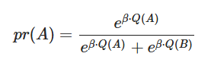
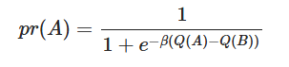
The Q-Learning model
We can calculate pr(A) using the softmax function as follows:
Alternatively, for a binary-choice task, a mathematically-equivalent way of writing the softmax function*:
Where β is the explore/exploit parameter, or degree of behavioural consistency
*This alternative equation may be helpful if you have β x Q values in the first equation that are too large to exponentiate (i.e., computes to infinity).

Slide 16
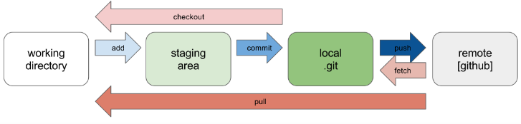
What’s Git?
An open-source revision control system that can be used to:
Host working files for your data projects
Share code with collaborators and iteratively revise scripts
Share code with reviewers/readers, especially for journals with open data access requirements

Slide 17
Git Workflow
Clone: When you want to freshly copy an entire repo onto your computer
Pull: When you want to update your existing copy of the repo to the latest version
Add: When you want to add your changes to your local staging area
Commit: When you want to save and update your changes to your local version
Push: When you want to push your committed changes onto the remote version

Slide 18
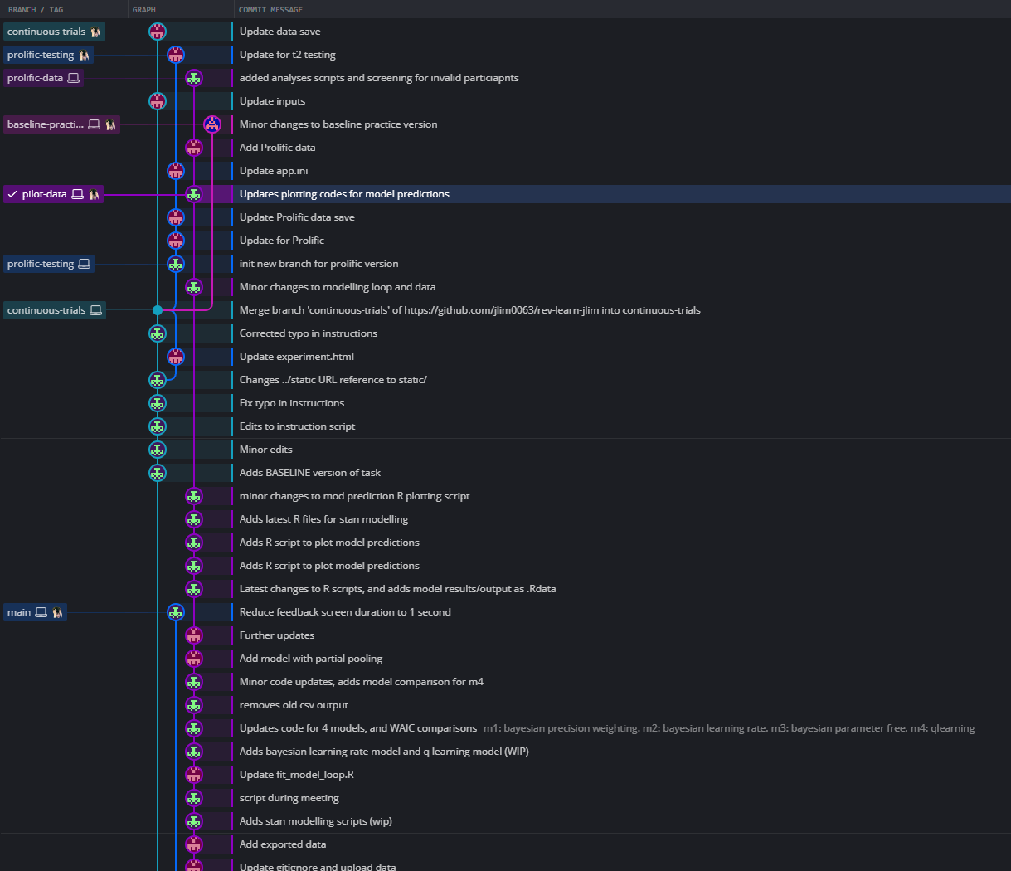
Git Branching
We use branches to add new or alternative features (versions) of the “main” branch.
We branch when working on new or alternative features so as not to disrupt the development of the “main” branch, especially if you already have a functional “main” and don’t want to overwrite it destructively.

Slide 19
What is Git Bash?
Application for Microsoft Windows environments which provides an emulation layer for a Git command line experience
Can serve as an alternative to Command Prompt on Windows, or Terminal on Mac
Install git:
https://github.com/git-guides/install-git

Slide 20
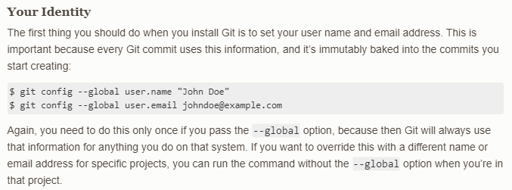
Installing Git and Git Bash on your system
Install git:
https://github.com/git-guides/install-git
To check your Git settings, type into Git Bash:
git config --list

Slide 21
Git Workflow
Clone: git clone
Pull: git pull
Add: git add .
Commit: git commit –m “message here”
Push: git push origin [branchname]
Create new branch and switch to new branch: git branch -b [branchname]
Switch to another branch: git checkout [branchname]

Slide 22
Link to all commands you can type into Git Bash
https://github.com/joshnh/Git-Commands

Slide 23
Hamiltonian Monte Carlo with cmdstanr
20 May 2024
Light and Divine Winds
Ruben Pang

Slide 24
Hamiltonian Monte Carlo
Hamiltonian Monte Carlo is a type of algorithm amongst many in the class of Markov Chain Monte Carlo algorithms
MCMC algorithms draw samples repeatedly from a probability distribution, and are used to make inferences about probability distributions that are too complex or too high-dimensional to model with traditional statistical techniques
These algorithms learn via Bayesian inference. Every time it samples a parameter value, it learns from it, and uses it to inform the next sampling iteration
In Bayesian terms: forming a posterior to use as the prior for the next iteration, then updating the prior with new information.

Slide 25
Hamiltonian Monte Carlo
Because these are “learning” algorithms, you first have to give them a starting point. In other words, you have to give them a prior distribution to start with.
This is usually informed by what you think the true distribution of parameter values look like.
For example, let’s say you want the model to estimate the average height of a healthy adult sample (in cm) using a bunch of other physical measures.
A reasonable starting prior distribution would use the population parameters. So, we can specify a mean of 170cm and a standard deviation of 7cm.
We also know that it is highly unlikely a healthy adult would be below, say, 100cm, and taller than 250cm. So, to help the model learn faster, we can specify lower and upper bounds of 100 and 250.

Slide 26
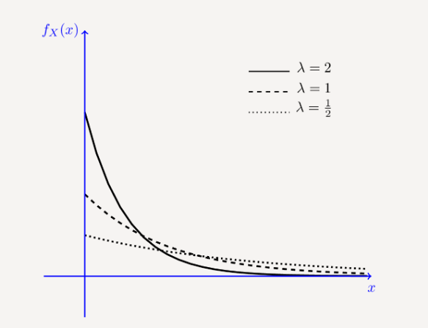
Hamiltonian Monte Carlo
Another example:
Let’s say we want to estimate the sample reaction time to a reaction time task
A reasonable prior would approximate an exponential distribution
What would be a reasonable guess for how reaction time is distributed in the general population?
It is unlikely anyone has 0 reaction time, and impossible for anyone to have negative reaction time.
BUT the typical human does have a fast reaction time of <1 sec
It is also unlikely that individuals have reaaaally long reaction times. It becomes more unlikely the higher the RT value is.

Slide 27
Hamiltonian Monte Carlo
Cognitive parameters often need constraints on their distributions, depending on:
The functional form of the model
The theoretical meaning of the parameter
For example, in the Q-Learning model, we tend to constraint the learning rate η to fall between 0 and 1. How we do this in Stan is through first specifying a normal distribution (mean = 0, sd = 1), and then passing it through a standard normal cumulative distribution function
In R, the function to perform cdf transformation is pnorm
In Stan, the equivalent is Phi_approx

Slide 28
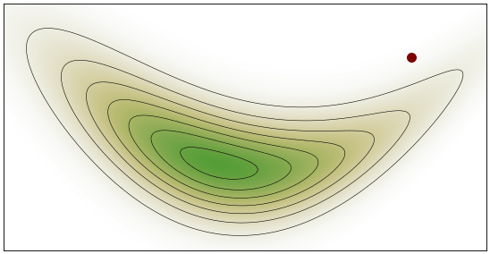
Hamiltonian Monte Carlo
Exploring the parameter space
The particle learns more about the true distribution each time it samples

Slide 29
Hamiltonian Monte Carlo
To set up the sampling process, we need to specify the:
Number of “warmup” iterations
Number of sampling iterations

Slide 30
Hamiltonian Monte Carlo
We need warmup iterations to give time for the computer to learn.
This is just like administering a cognitive task and including a practice phase.

Slide 31
Hamiltonian Monte Carlo
When we extract parameters from model outputs, we are not extracting one single value per parameter.
We are in fact extracting all the sampled values over X number of iterations, and then using their median as the aggregate value of that parameter.

Slide 32
Priors affect how well your model converges
When a “particle” wanders too far off its initial value and target distribution, this results in a
divergent transition.

Slide 33
Priors affect how well your model converges
Divergence can also be (and even more commonly) caused by coding errors, e.g.,:
Having the wrong mathematical operator
Forgetting to transform/constrain your parameters when they should be transformed/constrained

Slide 34
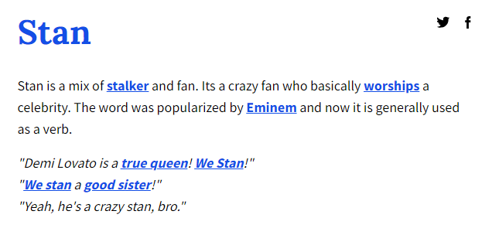

Stan models and cmdstanr
What is Stan?
A platform for high-performance statistical computation
Stan code itself is a derivative of C++, a compiled language. Hence, any Stan script you write will need to be compiled into a .exe file before it can be executed.
Stan itself interfaces with most of the top data analysis languages, including R, Matlab, Python…
The cmdstanr package is the method by which R interfaces with Stan code. Through cmdstanr functions, you can compile scripts, fit models, and extract model outputs

Slide 35
Stan models and cmdstanr
For the purposes of our tutorial, you don’t need to be proficient writing code in Stan.
You will just need to understand enough to know
Common errors in compiling your Stan script
What each code section does
How to tweak parameters on your own
How to spot when your model has divergence issues
Feel free to consult on more complex issues.

